Slide 1


MIPS Processor Comparison
16-Bit Single-Cycle vs 32-Bit Single Cycle
Implemented in Verilog
Sean Wygant
Heba Hafez
Daniel Mondragon
Ricardo Herrera-Pineda
ECE 4300: Computer Architecture
November 2025

Slide 2
Project Overview
Project Mission
Design, implement, and benchmark two MIPS processors using Verilog HDL: a 16-bit single-cycle processor and a 32 single-cycle processor to analyze performance differences in architectural design.
Build
Test
Compare
Two MIPS processors
Run test programs
Measure performance

Slide 3
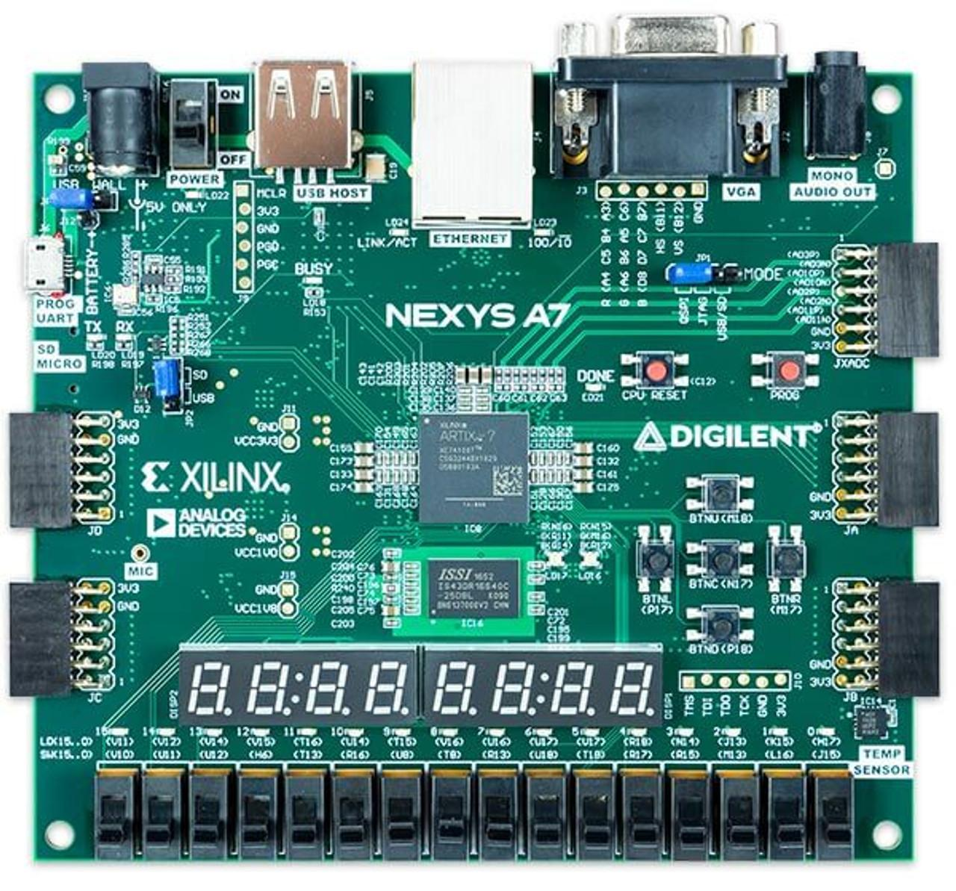

Tools we used:
Nexys A7 100T
AMD Xilinx Vivado

Slide 4
What is MIPS?
MIPS stands for Microprocessor without Interlocked Pipeline Stages. It's a RISC architecture known for its simplicity and educational value.
Single-Cycle Architecture
1
2
3
Each instruction completes in exactly one clock cycle
Simpler to understand than pipelined designs
Clock period set by longest instruction path

Slide 5
Key Architectural Differences
Execution Model
Data Path Width
Single-Cycle: One instruction per cycle
16-bit: 16-bit buses and operations
Pipelined: Multiple instructions in flight
32-bit: 32-bit buses and operations
Clock Cycle Time
Complexity
Single-Cycle: Slowest instruction sets clock
Single-Cycle: Simple, no hazards
Pipelined: Shortest stage sets clock
Pipelined: Needs forwarding, stalls, flushes
Performance Trade-offs
Pipelined architecture offers higher throughput but adds complexity. 32-bit handles larger data but requires more hardware resources.
We chose to use 32-bit and 16-bit single cycle variants due to the simplicity and speed of implementation.

Slide 6

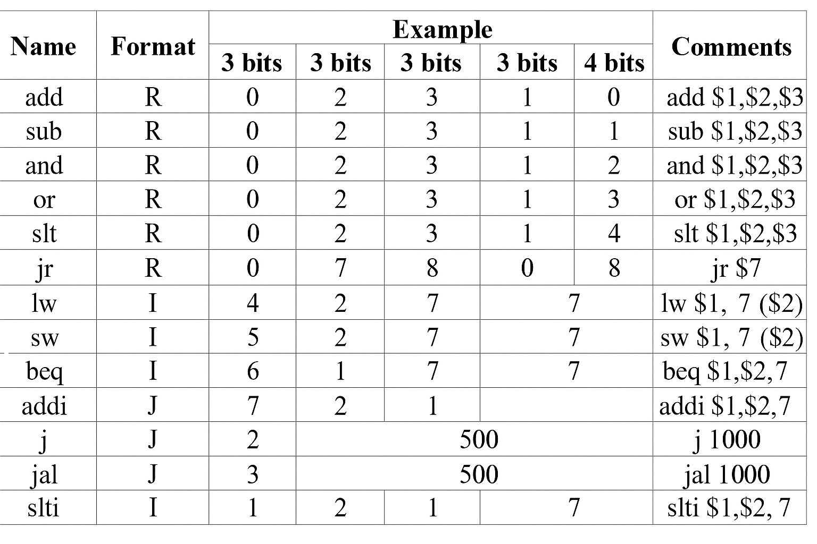


MIPS Instruction Formats
All Instructions are 16 or 32 bits depending on architecture
R-type
Register operations
add, sub, and, or, slt, jr
I-type
Immediate operations
addi, lw, sw, beq, slti
J-type
Jump instructions
j, jal

Slide 7


Architectural Differences
16-Bit Single-Cycle
32-Bit Single-Cycle
Each instruction in one cycle
16-bit data path
8 registers (3-bit addressing)
13 instructions
Max memory space: 64 KB
Each instruction in one cycle
32-bit data path
32 registers (5-bit addressing)
13 instructions (we can go up to ~8192)
Max memory space: 4 GB

Slide 8
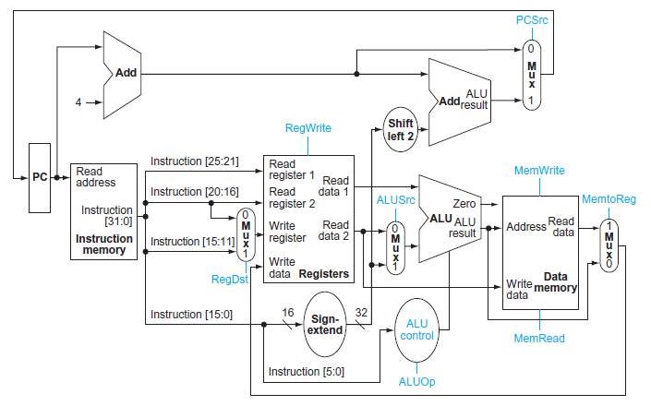
Processor Datapath
Key Components
Program Counter
Tracks current instruction
Instruction Memory
Stores program code
Register File
8 or 32 general-purpose registers
ALU
Performs arithmetic operations
Data Memory
Load and store data

Slide 9
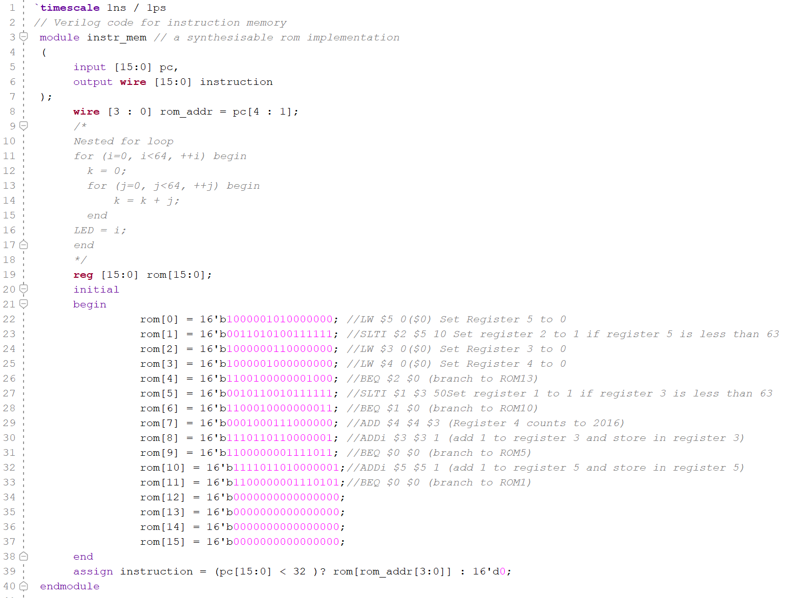
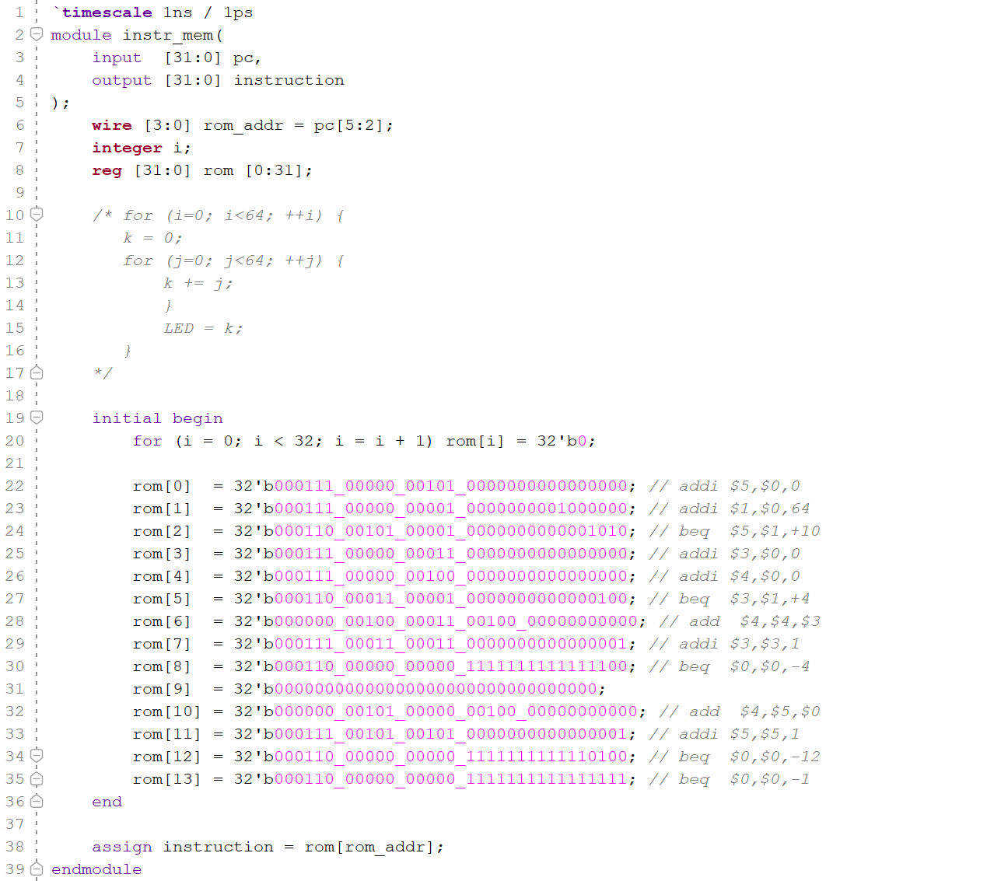
The instructions for both architectures
16-Bit
32-Bit

Slide 10
Test Program
Summation Algorithm
Sum = 0 + 1 + 2 + 3 + ... + 48 + 49
• Register $3: Tracks current value of n
• Register $4: Stores running sum (displayed on LEDs)
• Loop limit: 49 (hardcoded)
• Expected result: 1,225 (using formula n(n+1)/2)

Slide 11
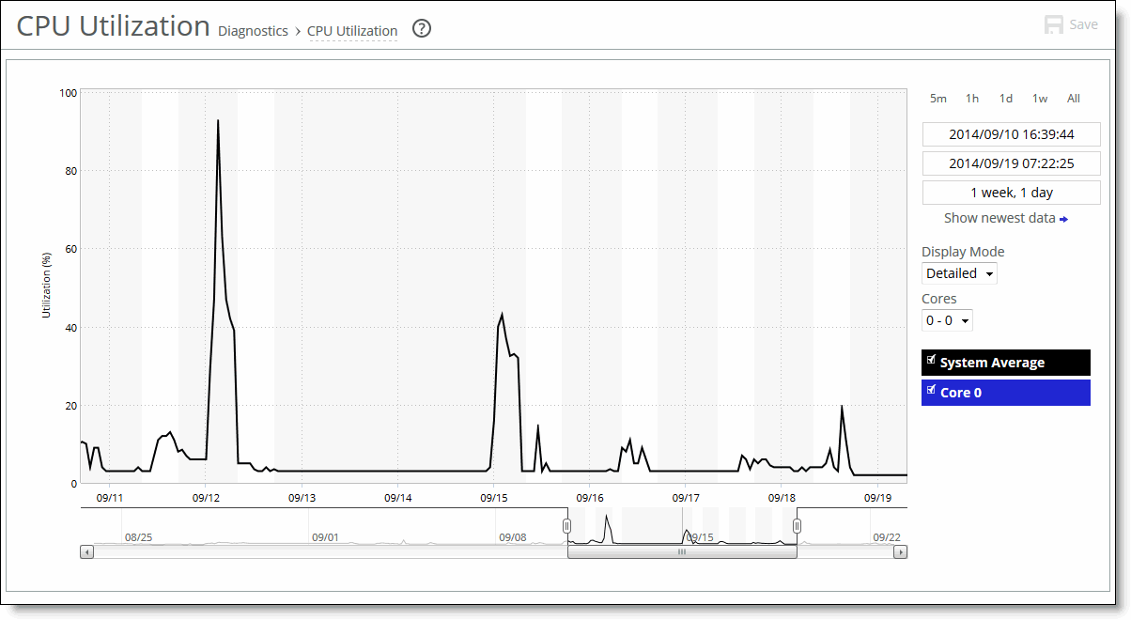
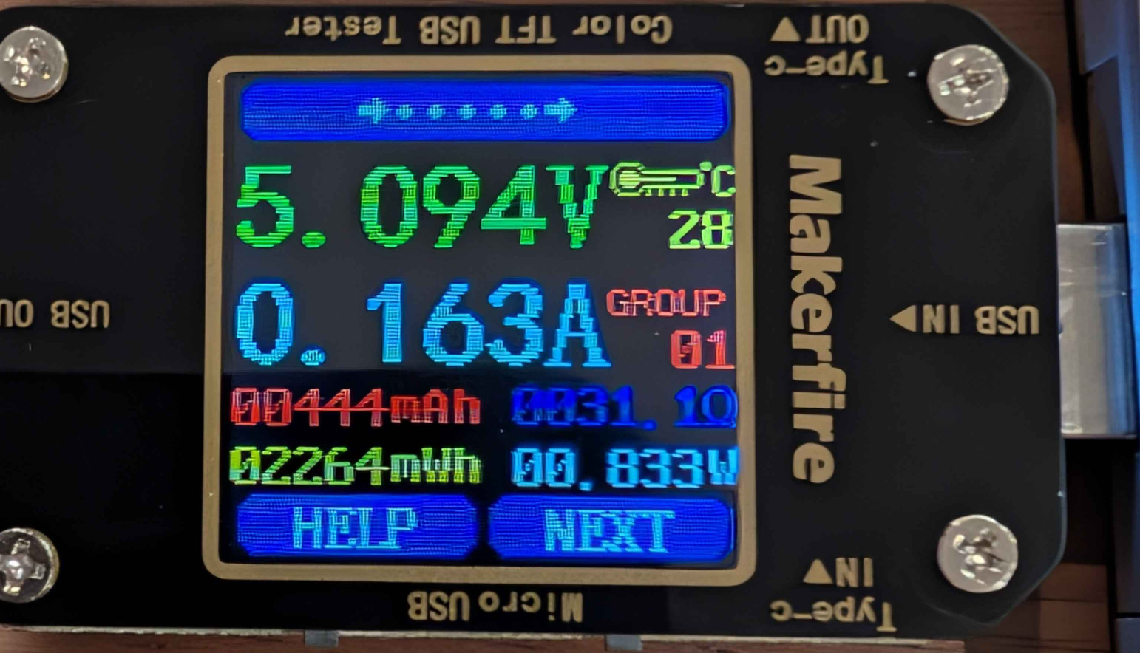
Performance Metrics
Metrics to Measure
Execution time
Clock cycles per instruction (CPI)
Power consumption
CPU utilization
Temperature

Slide 12
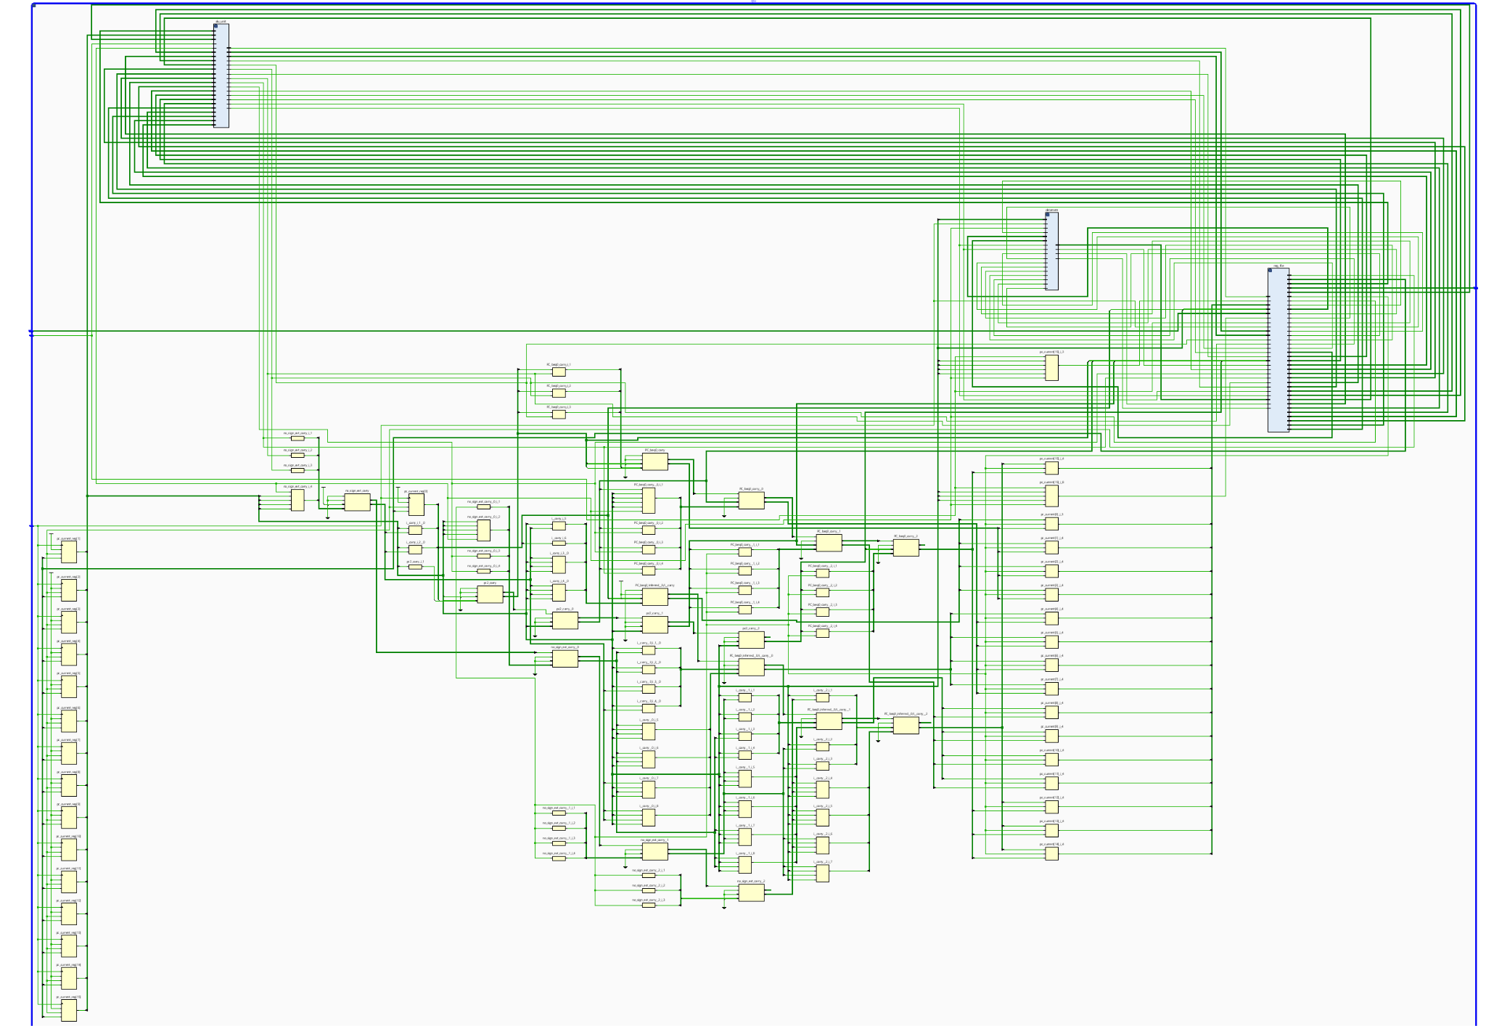
16 Bit Single-Cycle Processor Schematic in Verilog

Slide 13
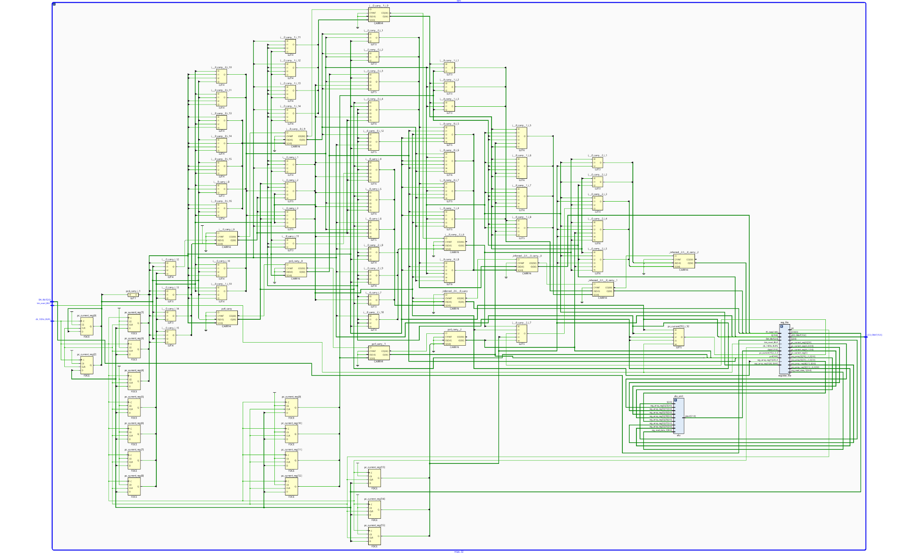
32 Bit Single-Cycle Processor Schematic in Verilog

Slide 14
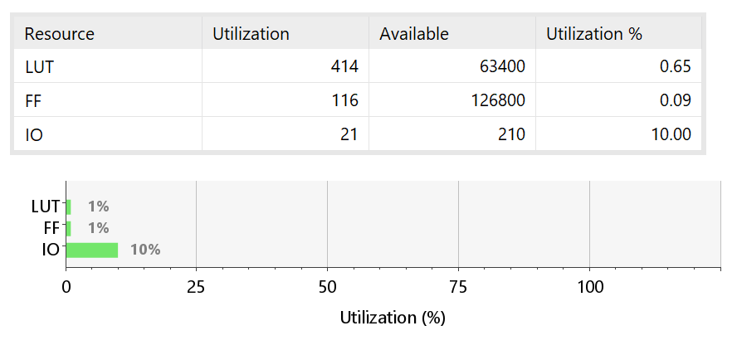
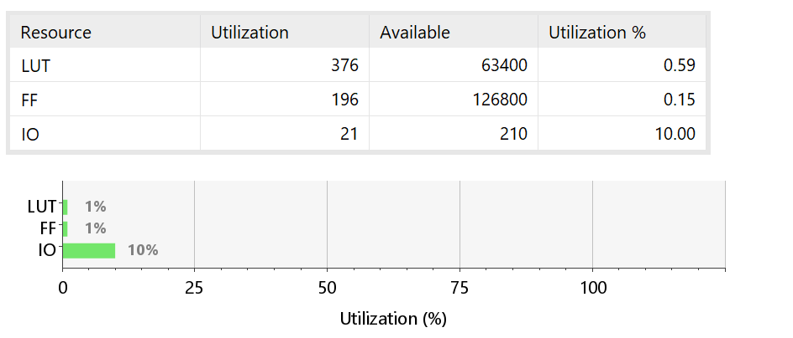
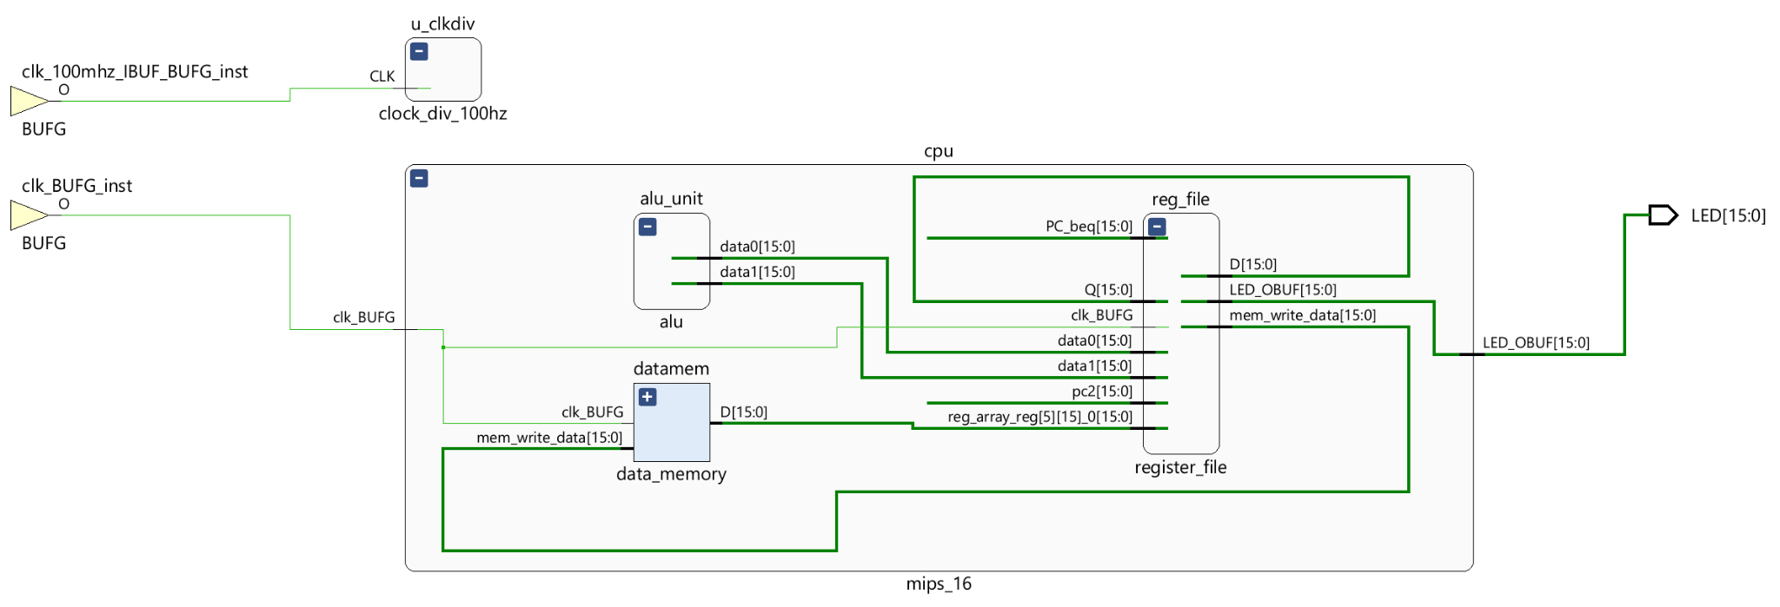
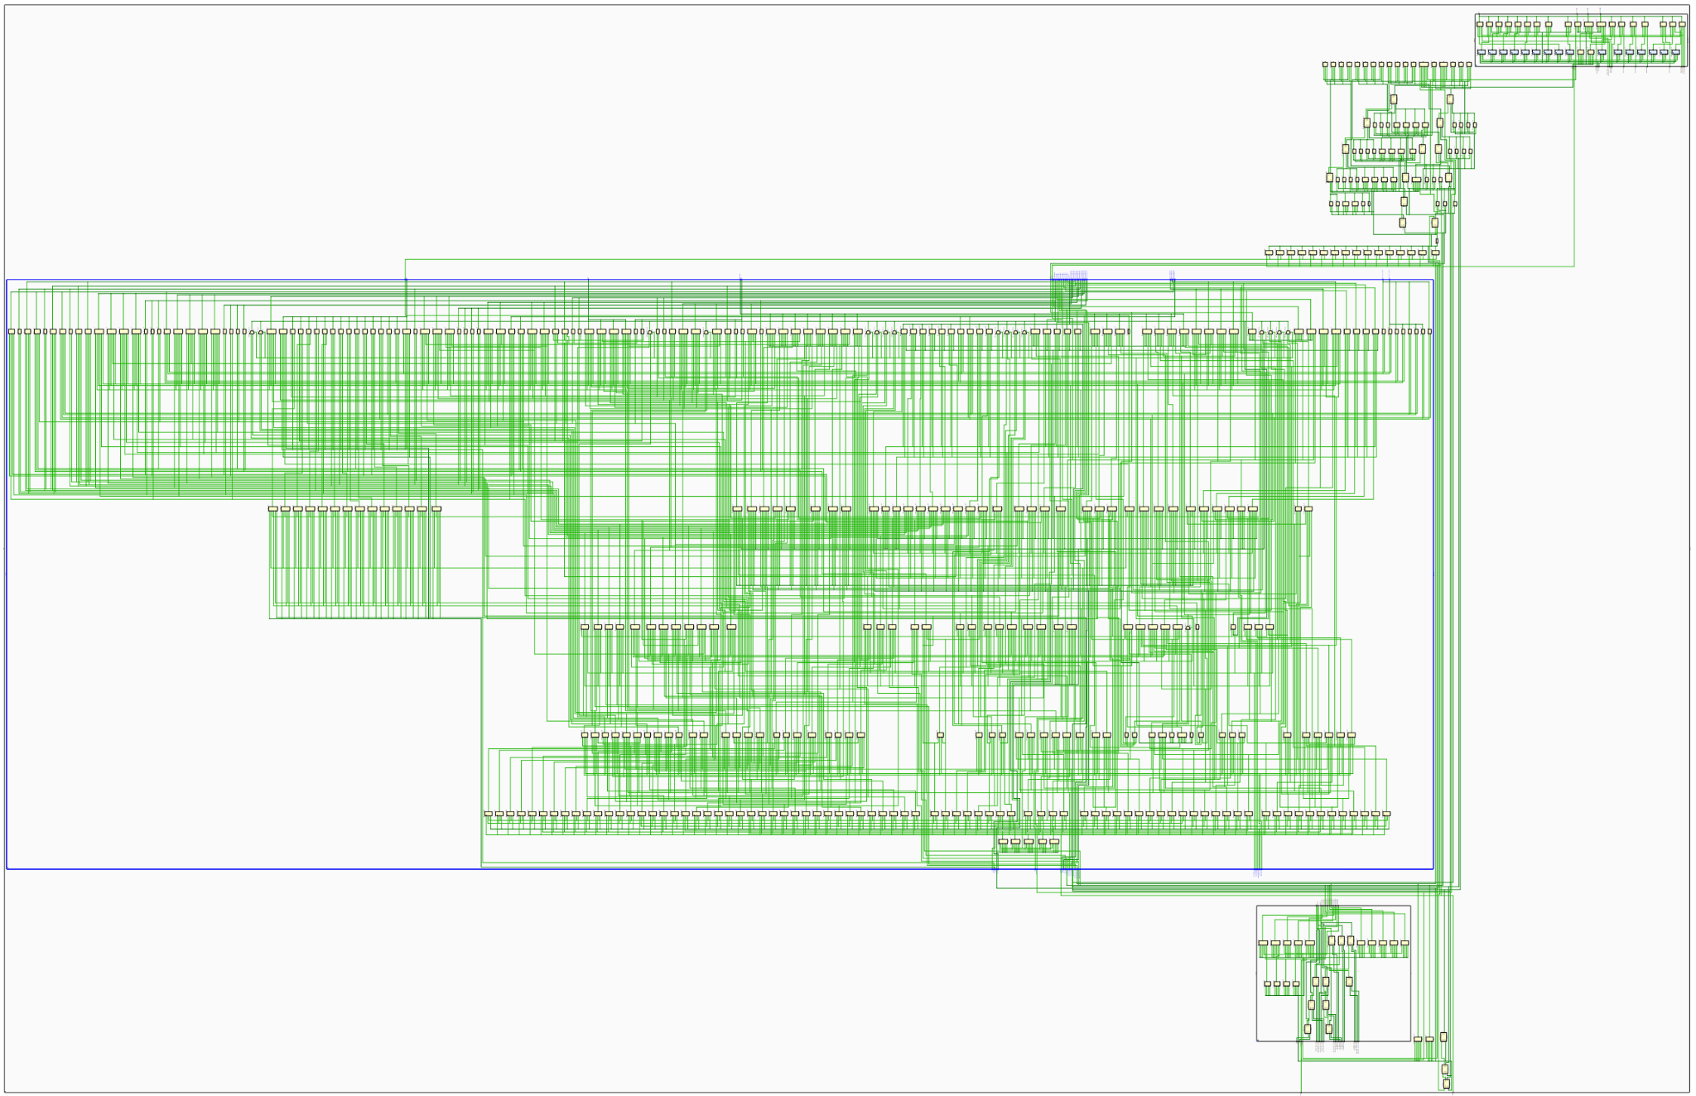
Board Utilization Tables
16-Bit
32-Bit

Slide 15
Resource Utilization Analysis
Resource
16-Bit
32-Bit
Winner
LUTs
414 (0.65%)
376 (0.59%)
32-bit ✓
Flip-Flops
116 (0.09%)
196 (0.15%)
16-bit ✓
I/O
21 (10.0%)
21 (10.0%)
Tie
Key Insight: Algorithmic Efficiency Matters!
• 16-bit uses MORE LUTs: Inefficient branch logic (5 operations vs 2)
• 32-bit uses MORE FFs: Wider data paths need more storage (expected!)
• The lesson: Smart algorithms beat brute-force narrowing

Slide 16
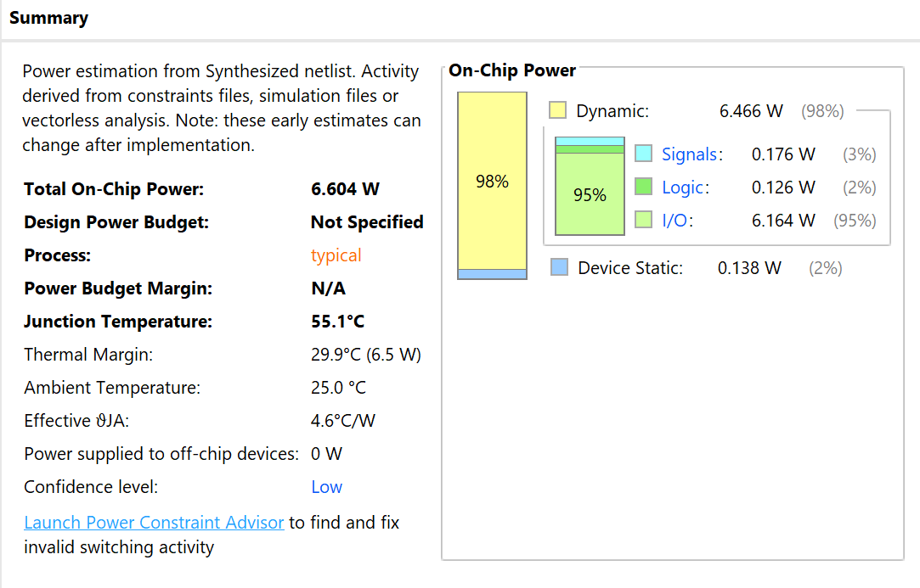
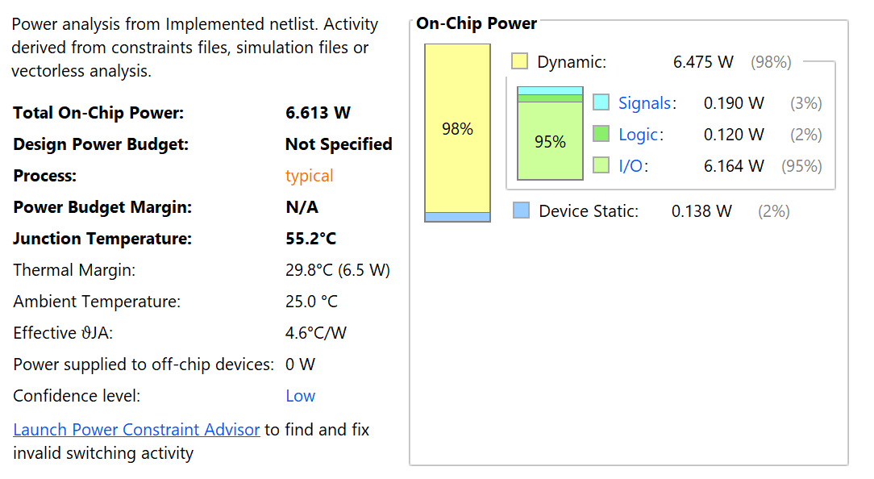

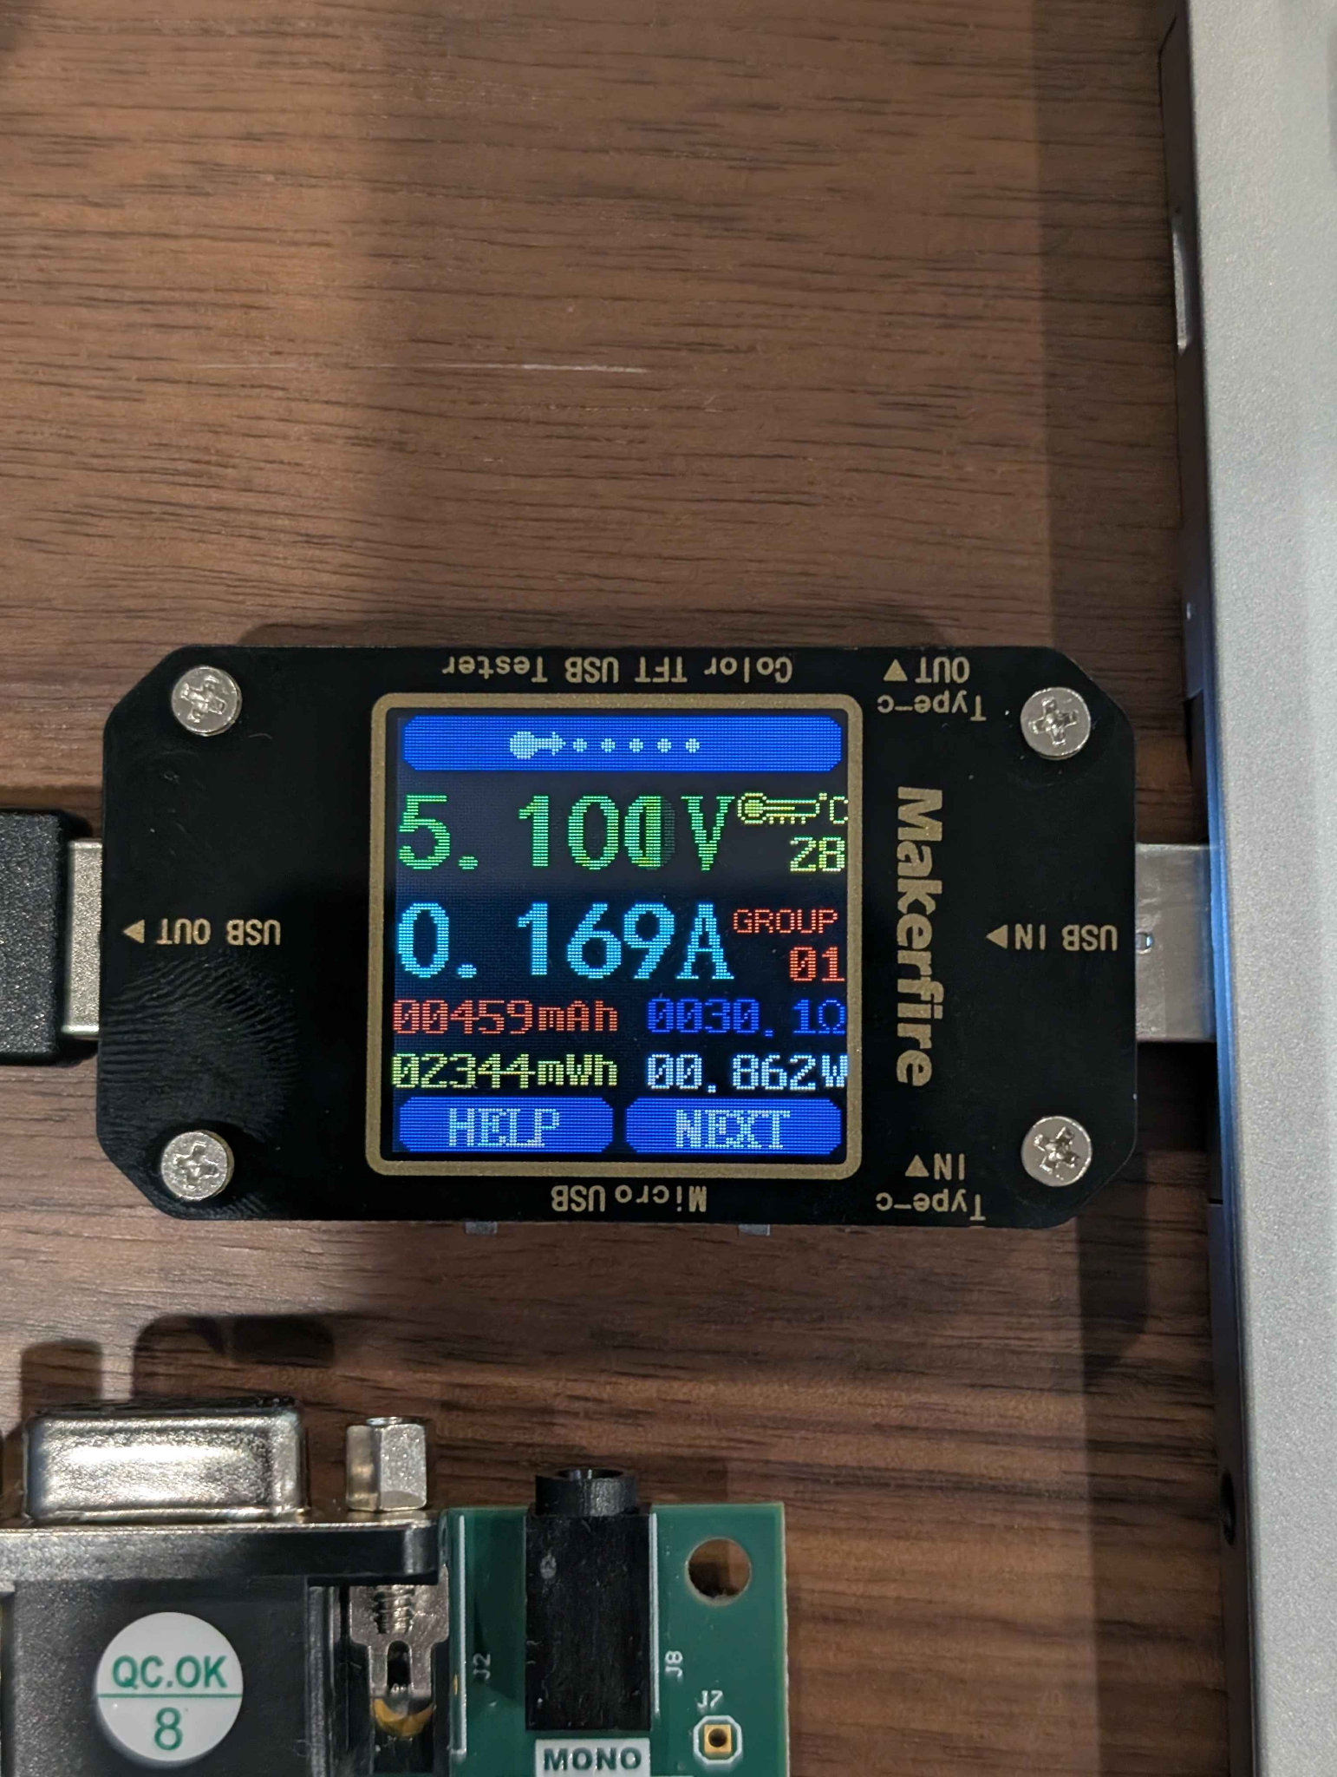
Power Draw
16-Bit
32-Bit

Slide 17
Power Draw Analysis
16-Bit
32-Bit
Total Power: 6.604 W
Total Power: 6.613 W
Dynamic: 6.466 W (98%)
Dynamic: 6.475 W (98%)
Signals: 0.176 W (3%)
Signals: 0.190 W (3%)
Logic: 0.126 W (2%)
Logic: 0.120 W (2%)
I/O: 6.164 W (95%)
I/O: 6.164 W (95%)
I/O dominates (95%)! 32-bit uses +8% signal power, -5% logic power → Nearly equal total

Slide 18
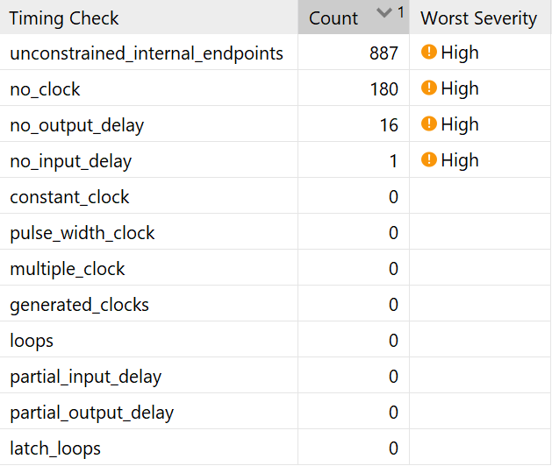
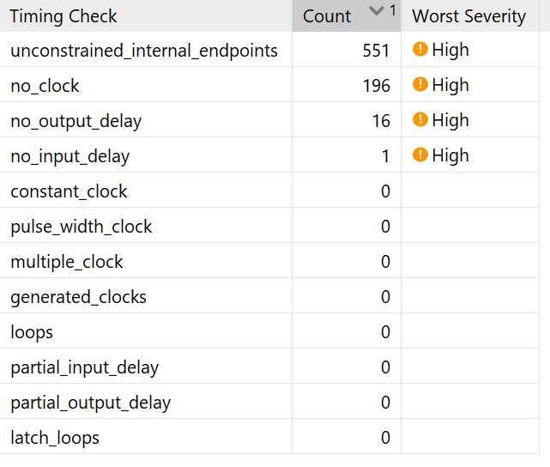
Timing Reports (Clock was set to 10kHz)
16-Bit
32-Bit

Slide 19
Timing Reports (Clock: 10 kHz)
16-Bit
32-Bit
unconstrained_internal_endpoints
887
551
no_clock
180
196
16-bit has 61% MORE endpoints (887 vs 551)
Complex branch logic creates more intermediate signals and registered stages
At 10 kHz, both have enormous timing margin—no actual violations!

Slide 20
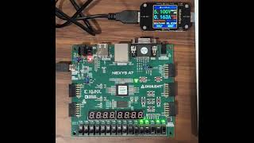
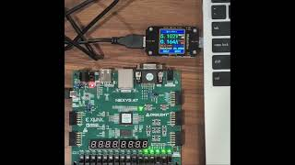
Videos
Mips16 10kHz execution time @ 0.25x, speed = 8.07s
Mips32 10kHz execution time @ 0.25x, speed = 6.70s

Slide 21
Results
MIPS 16 executes 20,354 instructions
MIPS 32 executes 16,836 instructions
MIPS 16 requires 21% more instructions to perform the same calculation.
MIPS 16 executes the summation loop in 8.07s
MIPS 32 executes the summation loop in 6.70s
Overall speedup of 21% due to the decrease in instruction count.
MIPS 16 requires 0.833W using a 10 khz clock
MIPS 32 requires 0.862W using a 10 khz clock
MIPS 32 uses just 4% more power to perform the same calculation.

Slide 22
Key Findings Summary
Performance Winner: 32-bit ✓
• Instruction Efficiency:
21% fewer instructions, 21% faster execution
• Resource Efficiency:
9% fewer LUTs (better algorithm!), more FFs (expected)
• Power Efficiency:
Nearly equal total power (~4% more), trades logic for signal power

Slide 23
Conclusions
What We Learned
- Architecture matters more than width alone
- 16-bit used MORE LUTs despite being narrower
• Root cause: Inefficient branch calculation algorithm
• Design principles observed:
- Simple algorithms → Fewer LUTs → Less logic power
- Wider data paths → More FFs → More signal power
- Good design balances complexity and width
Key Takeaway: Smart algorithms can overcome architectural limitations!

Slide 24
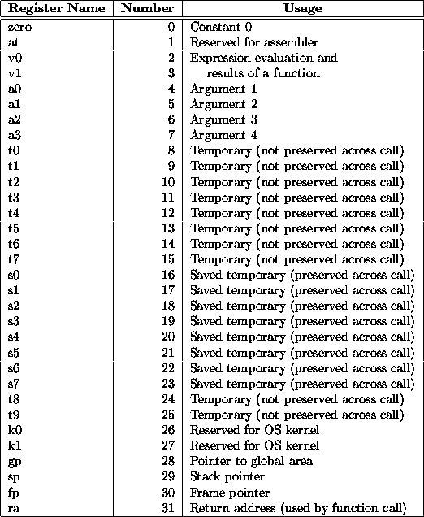
MIPS Register Set
32 General-Purpose Registers
Key Registers
$0: Always zero
$v0-$v1: Return values
$a0-$a3: Arguments
$t0-$t9: Temporaries
Special Registers
$sp: Stack pointer
$fp: Frame pointer
$ra: Return address
$gp: Global pointer

Slide 25
5-Stage Pipeline Architecture
IF - Instruction Fetch
Fetch instruction from memory using PC
ID - Instruction Decode
Decode instruction and read registers
EX - Execute
Perform ALU operations
MEM - Memory Access
Read from or write to data memory
WB - Write Back
Write results back to register file
Pipeline Registers
Hazard Handling
IF/ID, ID/EX, EX/MEM, MEM/WB store intermediate results
Forwarding, stalling, flushing resolve hazards

